Slide 1
Image Recognition on Simpsons Characters
Shamanthaka Veerareddy
Zahiduddin Mohammad
Nikhil Chennupati

Slide 2

Motivation
How these artificial intelligent systems are rivaling people’s ability to classify objects in photos and videos?

Slide 3
Dataset Details
Total number of images in the dataset : 14300
Train set : 11777
Test set : 2527

Slide 4
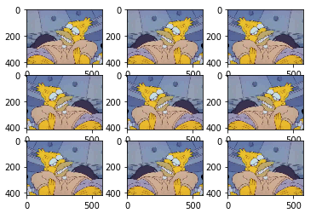
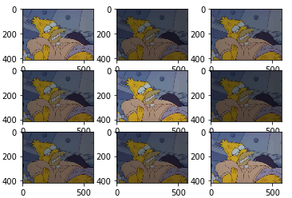
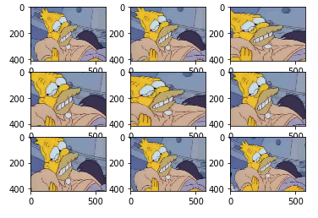
Preprocessing
Data Augmentation :
Horizontal flip
Random brightness
Zoom

Slide 5
Methods
Convolution Neural Networks (6-CNN, 4-CNN)
Random Forests
Image AI

Slide 6
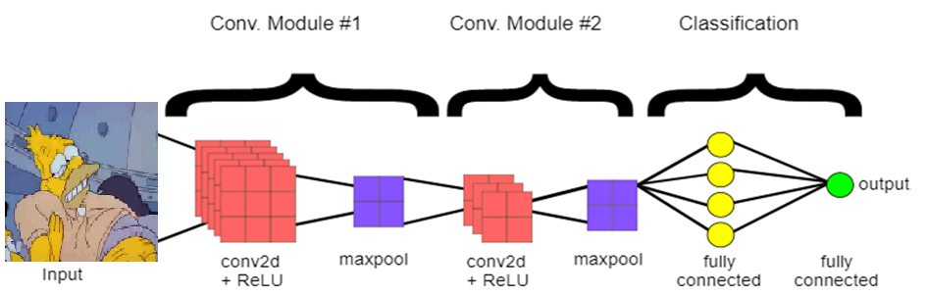
Convolution Neural Networks
CNN = Feature extraction + Fully Connected Network
Methods used for Feature extraction:
Convolution
Pooling
Notes:
Filters, strides, dropouts
https://medium.com/@RaghavPrabhu/understanding-of-convolutional-neural-network-cnn-deep-learning-99760835f148

Slide 7
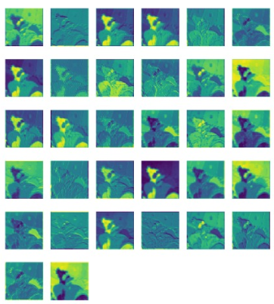
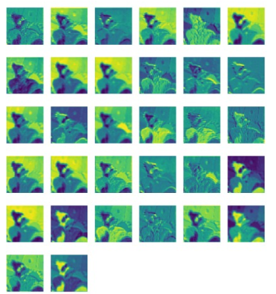
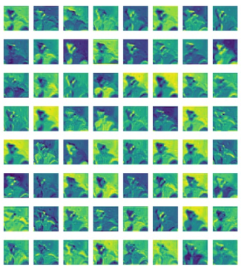
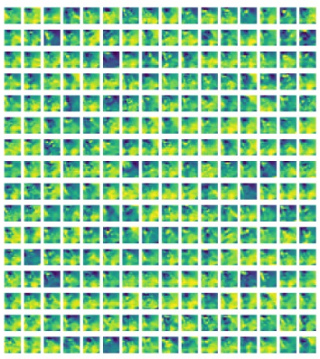
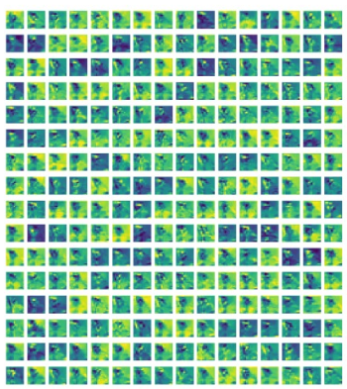
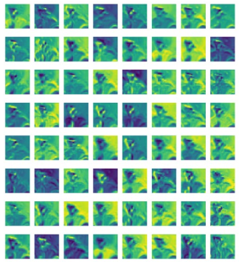
Activation/Feature Maps:
Conv2d_layer_1
Conv2d_layer_2
Conv2d_layer_3
Conv2d_layer_5
Conv2d_layer_6
Conv2d_layer_4

Slide 8
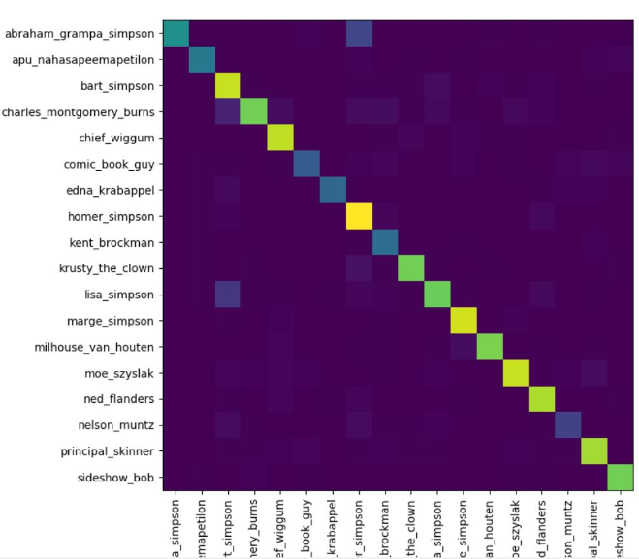
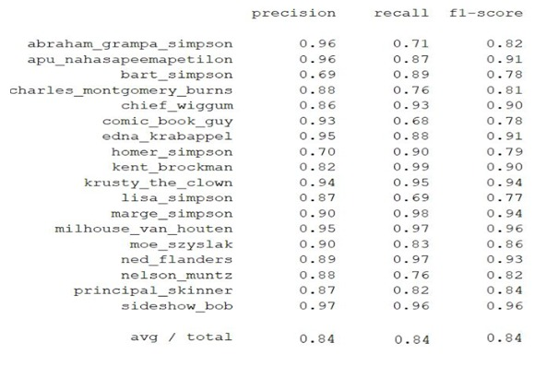
Results(4 CNN)
Accuracy: 84%

Slide 9
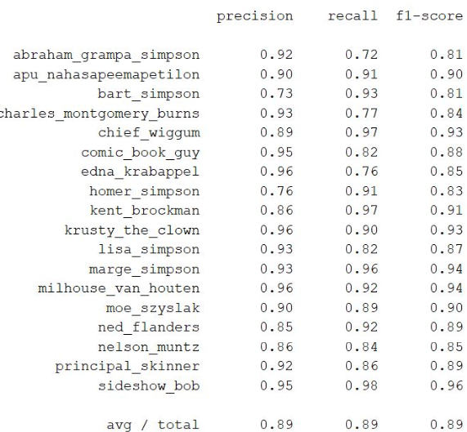
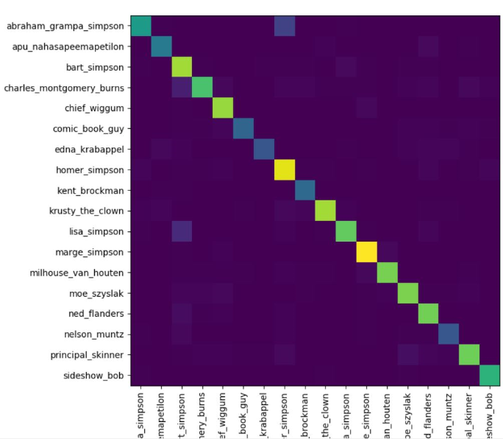
Results(6 CNN)
Accuracy: 89%

Slide 10
Insights
In case of 4-CNN model, the character Lisa Simpson has F1-score of 77% which is low compared to other characters.
The F1-score of Lisa gone up to 87% for 6-CNN as the model was able to learn more features.

Slide 11
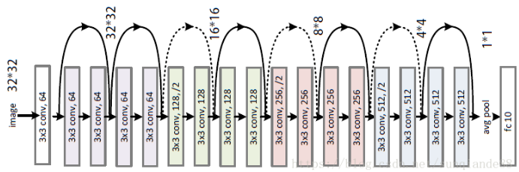
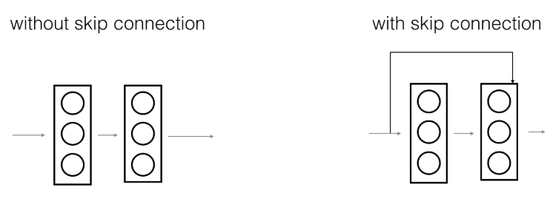
Image AI (Residual network)
Network with 18 convolution layers
It uses skip connections to avoid overfitting.
Notes:
Degradation Problem

Slide 12
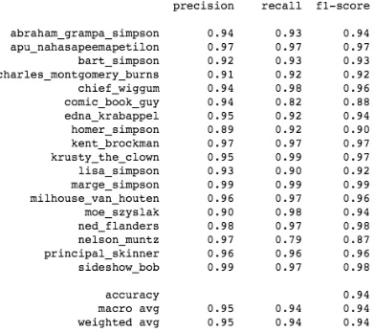
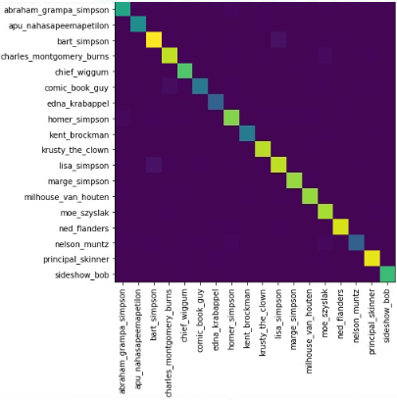
Results(Image AI):
Accuracy: 94%

Slide 13
Insights
In the test dataset, characters Homer Simpson and Comic book guy are accompanied by other characters which resulted in the decrease of the F1-score for both.

Slide 14
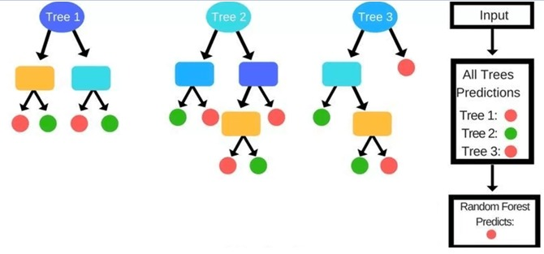
Random Forest
Randomly selected subset of training set
Splits are chosen according to a purity measure i.e., Gini index (classification)
Images are classified based on decision tree count.

Slide 15
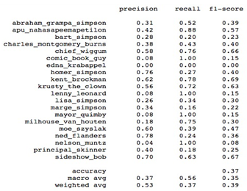
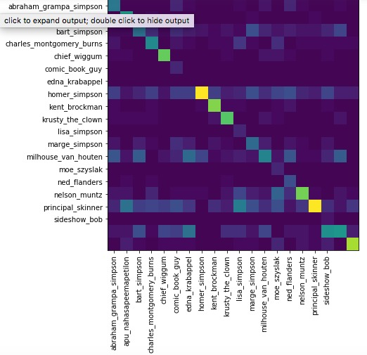
RF Result
Accuracy: 37%

Slide 16
Insights
Lack of feature extraction here might be the reason for lower accuracy.

Slide 17
Limitations:
Detecting single character in image
Training images for a character should have only that character in the image
Future Work:
Ability to detect multiple images in Images/videos.
Ability to draw a bounding boxes with the accuracy of corresponding character.

Slide 18

Individual Contribution:
Nikhil - Image AI Model
Zahid - CNN(6 layers), Data Augmentation
Shamanthaka - CNN(4 layers), Random Forests

Slide 19

Questions?

